Slide 1
Empowering Financial Security: Detecting Fraudulent Transactions using Advanced ML Techniques and Predictive Analytics
Presented by:
Huzefa Battiwala

Slide 2
Contents
Introduction
Types of fraud
Importance of Fraud detection
Understand the data
Model evaluation
Conclusion
Q&A

Slide 3

Introduction
What is fraudulent transaction?

Slide 4

Types of fraud transaction?
Credit card fraud
Check Fraud
Online payment fraud

Slide 5

Importance of fraud detection
Financial impact
Reputation protection
Consumer trust
Cost reduction

Slide 6
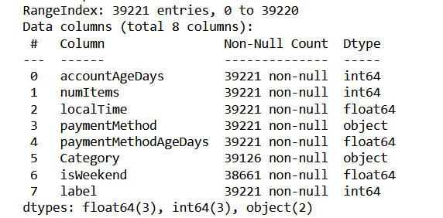
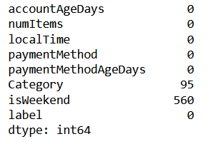
Understanding the data:
No. of features and observation
Missing values

Slide 7
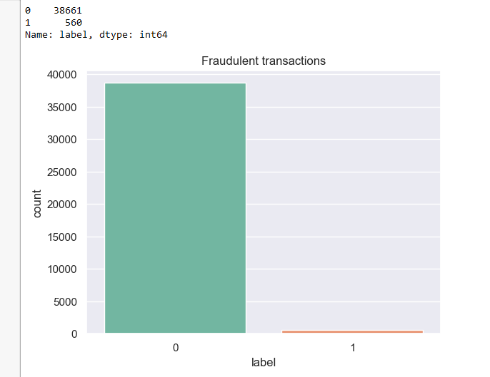
Imbalanced dataset

Slide 8
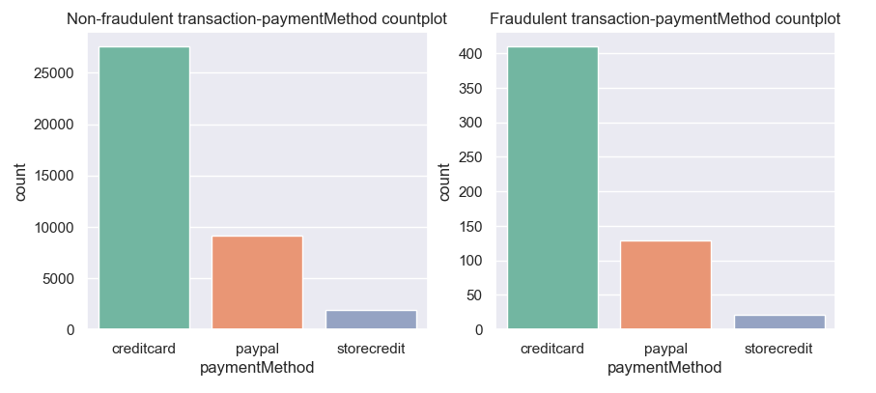
Bi-variate analysis – Payment method v/s target variable
Most of the customers are utilizing credit card for the transactions.
Out of total transactions ~1.5 % observations resulting into fraud for all payment method i.e creditcard, paypal and store credit.

Slide 9
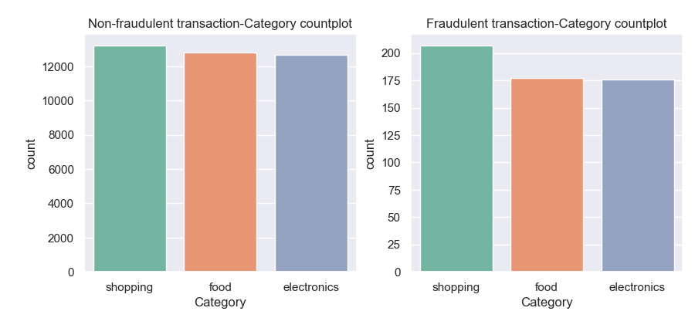
Bi-variate analysis – Category v/s target variable
Both fraudulent and non-fraudulent transactions exhibit nearly equal counts across the 'Category' variable.

Slide 10
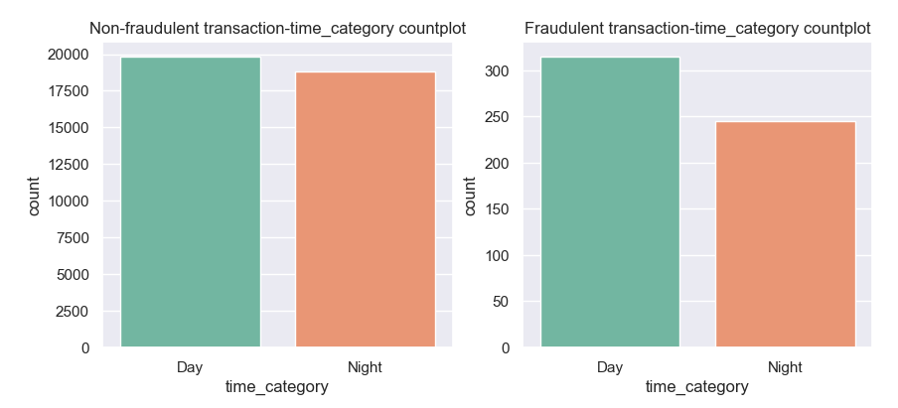
Bi-variate analysis – Time category v/s target variable
For non-fraudulent transactions, we observe nearly equal counts across the 'time_category' variable. However, for fraudulent transactions, there is a slightly higher occurrence during the day compared to the night

Slide 11
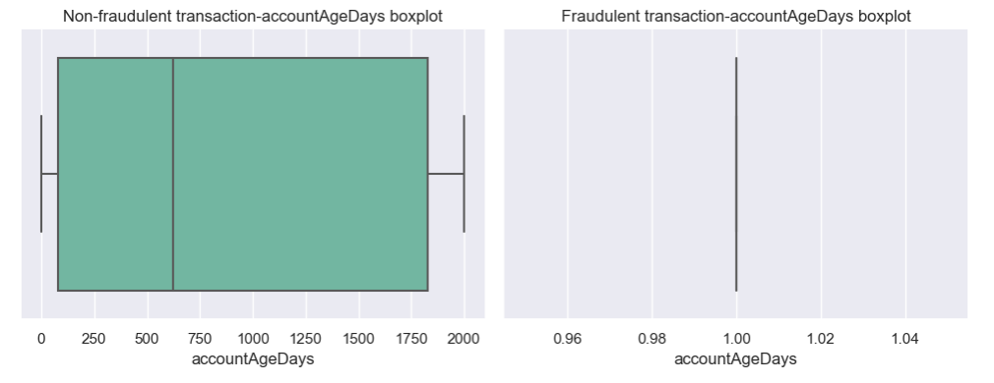
Bi-variate analysis – Account age days v/s target variable
For non-fraudulent transactions, the ‘Account age days’ range span from 2 to 2000. In contrast, for fraudulent transactions, the ‘Account age days’ is exclusively only 1.

Slide 12
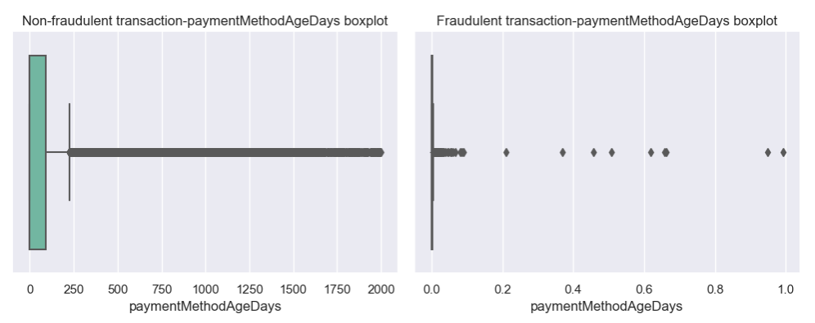
Bi-variate analysis – Payment age days v/s target variable
For non-fraudulent transactions, the ‘Payment age days’ range span from 0 to 2000. In contrast, for fraudulent transactions, the ‘Payment age days’ range span from 0.0 to 1.0

Slide 13
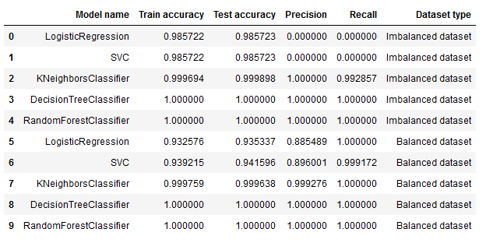
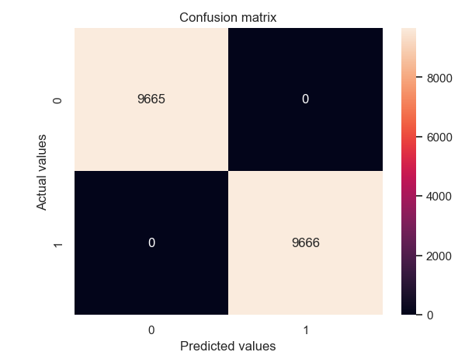
Model Evaluation

Slide 14
Conclusion
Overall there are ~1.4% of fraudulent transactions observed in dataset
Most of the customer are inclined towards use of credit card payment.
For fraudulent transactions, we observed that the 'Account age days' is consistently 1. This suggests that fraudulent activities are often associated with relatively new accounts.
Random forest is able to detect the fraudulent transactions on both balanced and imbalanced dataset with high precision and recall.
Next steps:
Enhanced Customer Background Verification.
Customer Education.
Regular training for model maintenance.

Slide 15

Q & A session

Slide 16
Thank you

